Slide 1



Mahindra First Choice Services
Driving business through data
Rohan Barghare
Suresh Chaudhari
Amey Gode
Mangesh Chaudhari

Slide 2
Business Problem
MFCS would like to expand their reach by increasing the customer service points. (Assumption – this could also be done in order to increase the market share by replacing competition)
They are targeting to open 60+ new workshops in a span of 15 months
Notes:
A business usually have either of these objectives –
Expansion – New workshops
Continuity – How to keep the good business consistent, maintaining the current demand supply consistent.
Profitability – By revising pricing strategy (altering price based on demand) OR reducing costs by identifying factors related to cost
Weaken competition – By opening centres closest to competition OR better service plans & packages, freebies, discounts, festive offers etc

Slide 3
Why solve this problem?
There could be multiple reasons to do this activity:
Understand ways to increase profitability
Maintain continuity of good business
Beat competition (understanding reach, geographical presence & identifying opportunity to open new centers)
Notes:
A business usually have either of these objectives –
Expansion – New workshops
Continuity – How to keep the good business consistent, maintaining the current demand supply consistent.
Profitability – By revising pricing strategy (altering price based on demand) OR reducing costs by identifying factors related to cost
Weaken competition – By opening centres closest to competition OR better service plans & packages, freebies, discounts, festive offers etc

Slide 4
Stakeholders Impacted
Stakeholders could be:
Marketing Head (understand the ROI & success metrics of various activities)
Sales Head (understand demand supply function based on various factors)
Operations Head (understand ways to achieve efficient processes & provide better customer service)
Notes:
A business usually have either of these objectives –
Expansion – New workshops
Continuity – How to keep the good business consistent, maintaining the current demand supply consistent.
Profitability – By revising pricing strategy (altering price based on demand) OR reducing costs by identifying factors related to cost
Weaken competition – By opening centres closest to competition OR better service plans & packages, freebies, discounts, festive offers etc

Slide 5
Let’s look at EDA part

Slide 6
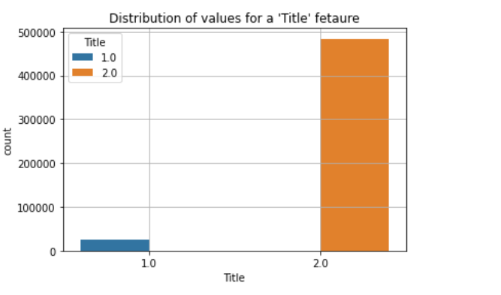
1.0 - Female 2.0 - Male

Slide 7
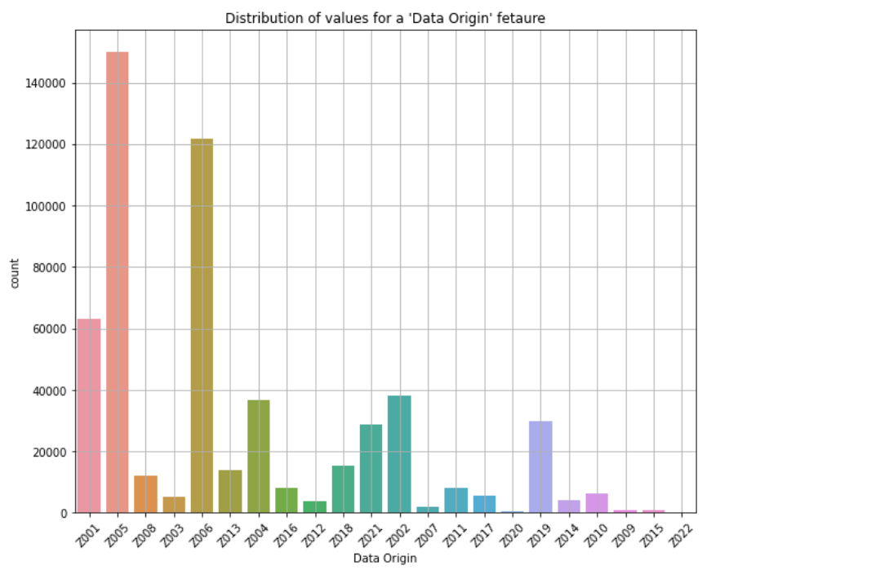
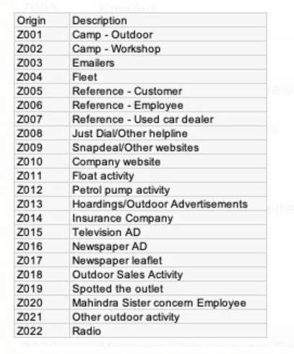

Slide 8
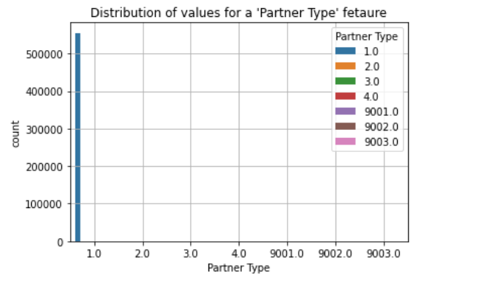
Type | Description
1 | Retail
2 | Corporate
3 | Fleet
4 | Employee
9001 | Insurance Company
9002 | Surveyor
9003 | Contact Person

Slide 9
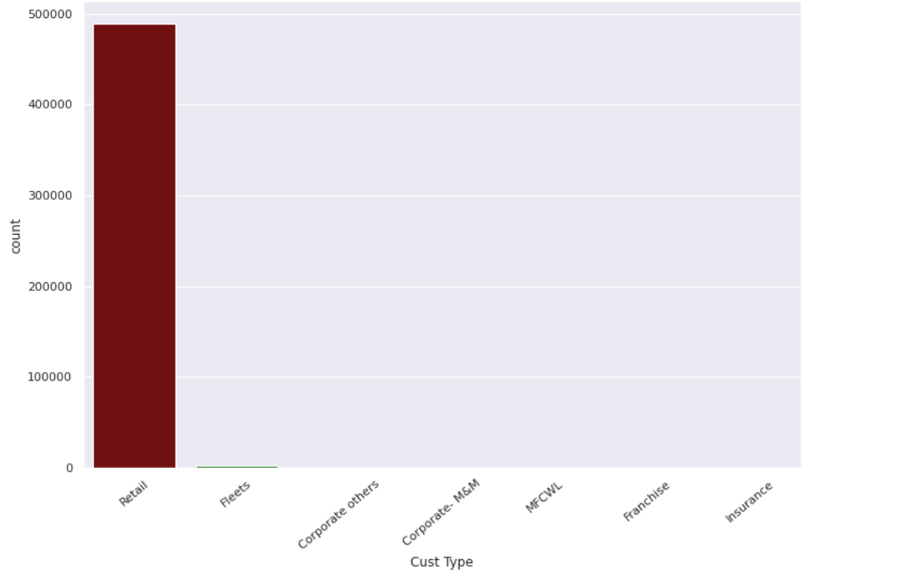

Slide 10
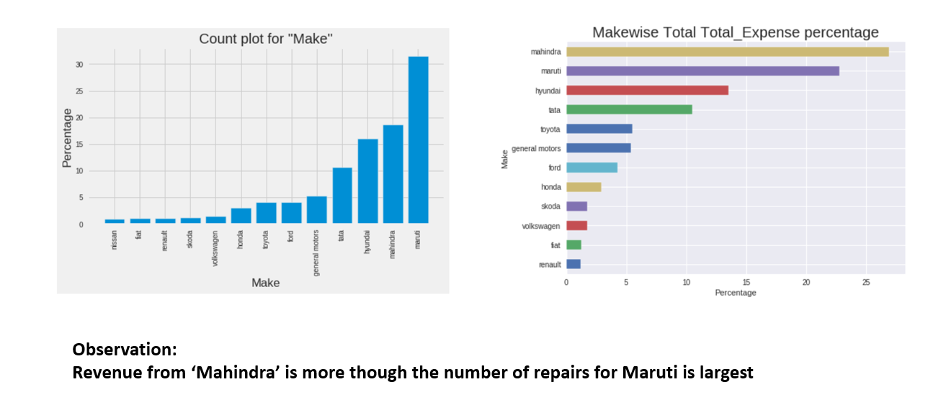

Slide 11
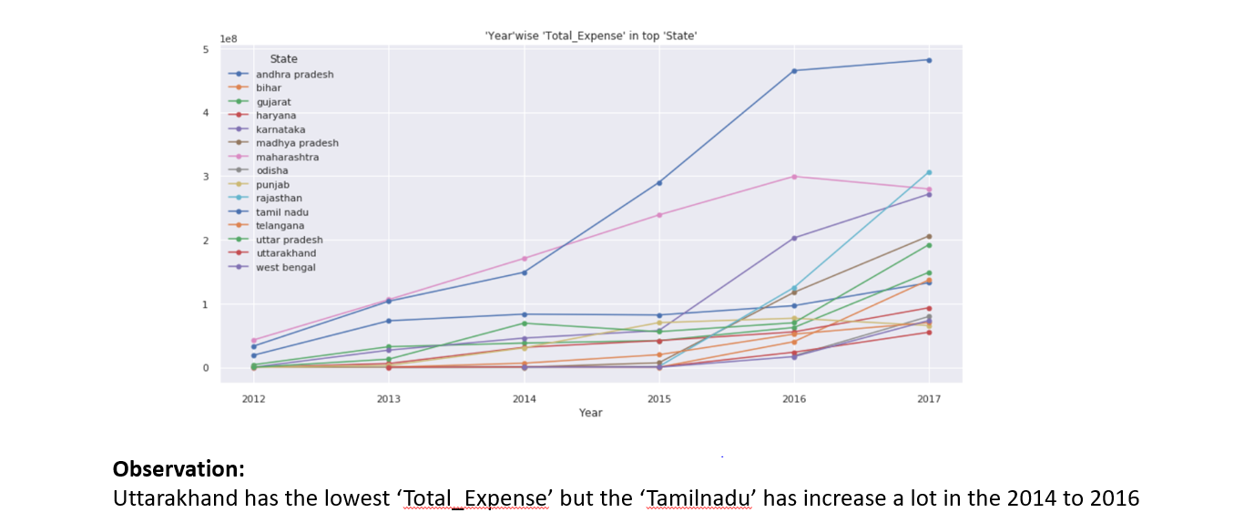

Slide 12
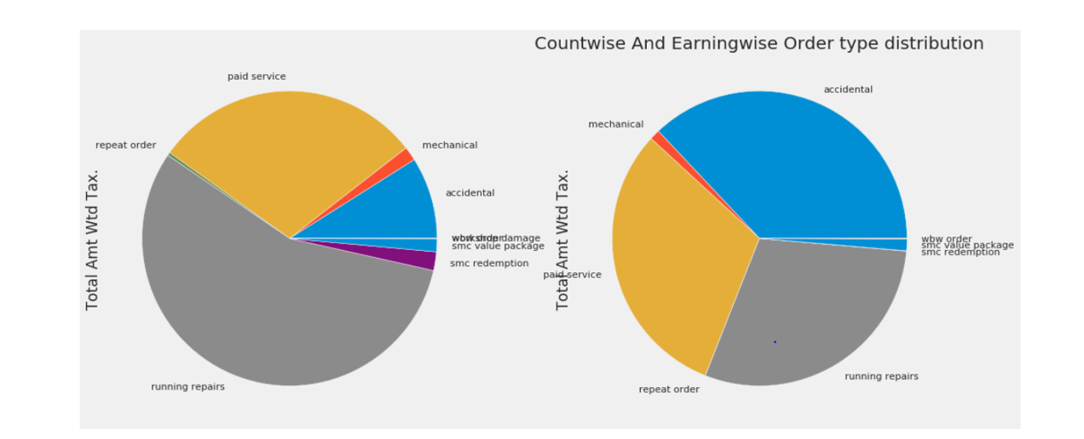

Slide 13
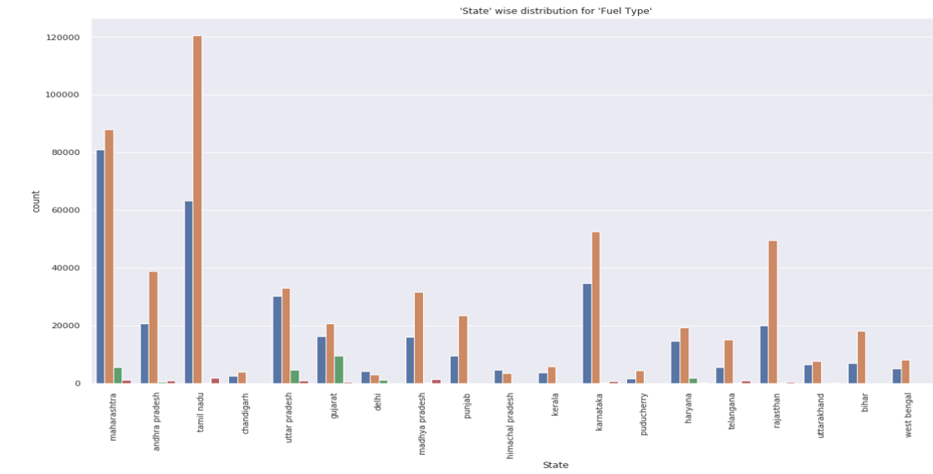

Slide 14
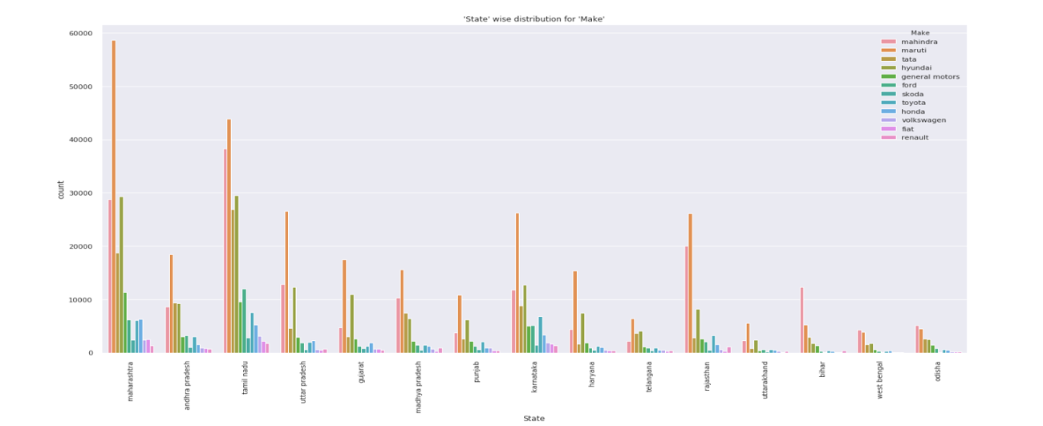

Slide 15
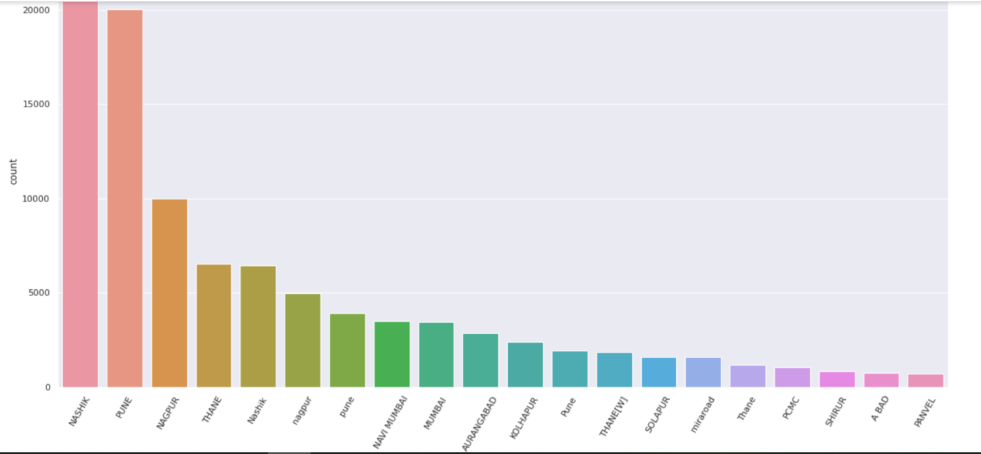

Slide 16
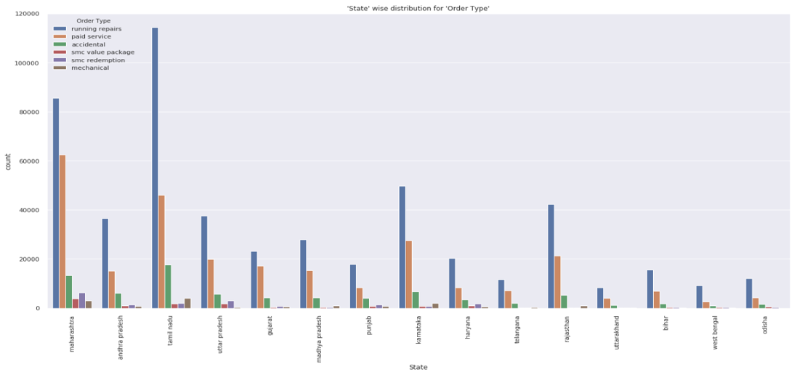

Slide 17
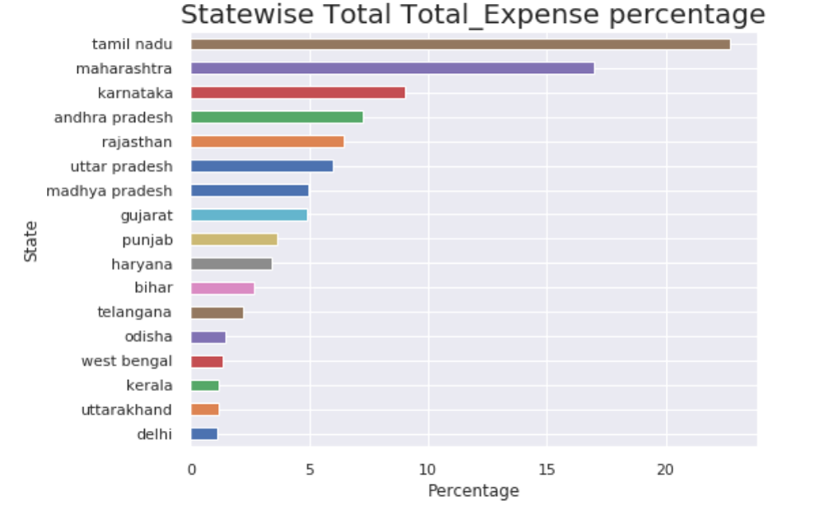

Slide 18
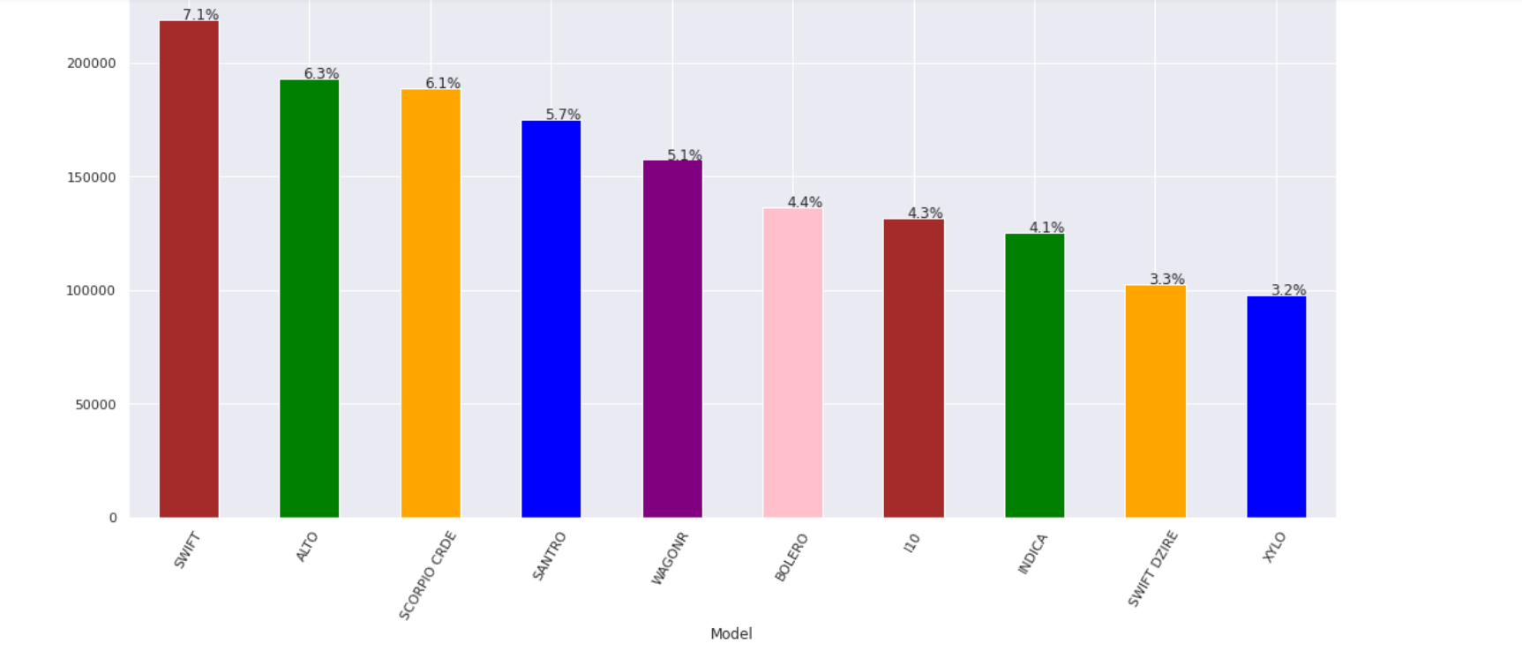

Slide 19
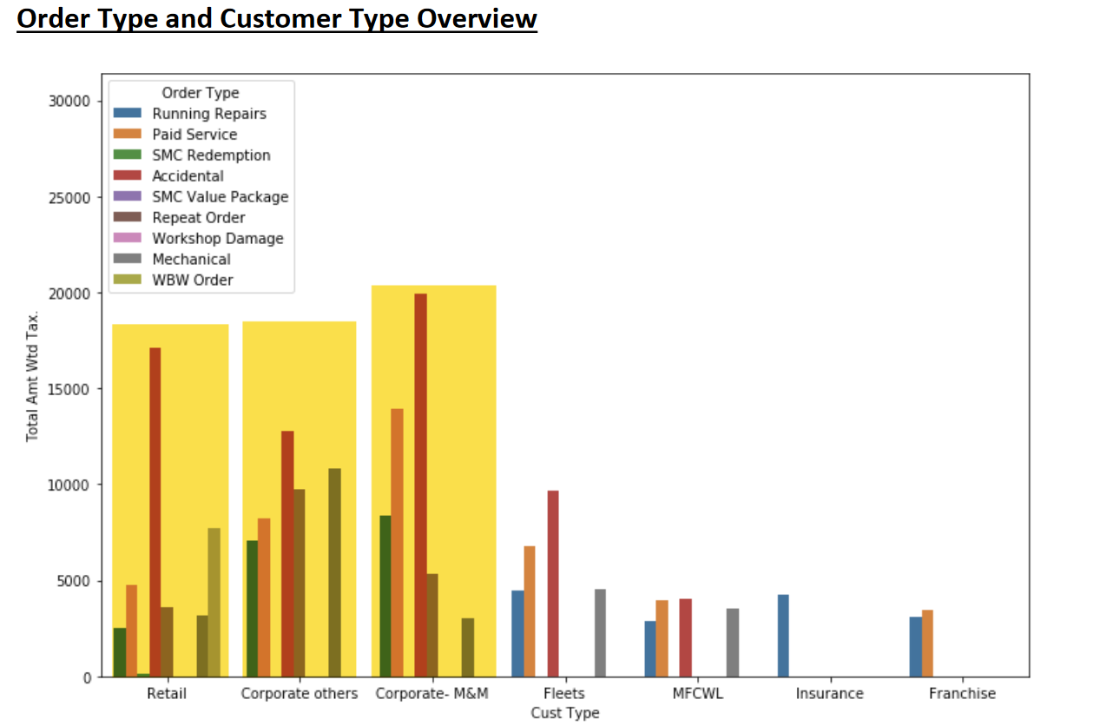
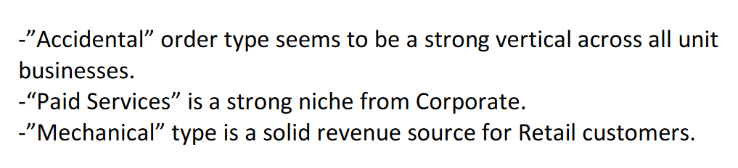

Slide 20
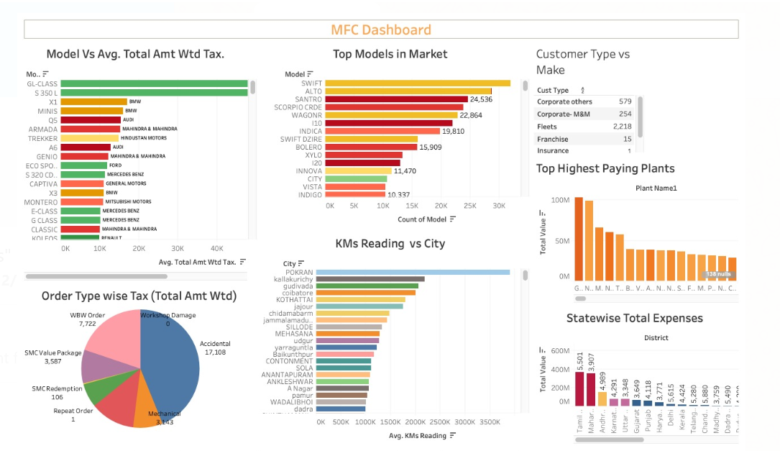

Slide 21
Insights
Looking at the Hatchback count and revenue distribution, it gives a definite idea of the lower servicing cost of this segment of cars.
SUV/Passenger tend to generate more revenue, as compared to their share by number of cars.
SUV’s are bought to be used on rugged terrain, thereby leading to more wear and tear and hence frequent servicing
SUV/Passenger are run for longer km’s due to their use in tour and travel industry
Mahindra & Mahindra being the second in the number of cars tops the revenue charts. Reasons:
The point above can be validated, SUV have high service need and generate more revenue
Mahindra owners would have a high footfall at company owned service centres

Slide 22
Insights
Maruti Suzuki has less accident counts but are expensive on Accidental repairs this could be attributed to reasons like less sturdy structure and inferior quality.
While Mahindra has high redemption on SMC packages, but least contribution in revenue, this could infer it needs to work on the pricing strategy of these packages
Pune has more cars, reasons could be lack of good public conveyance, low cost of living, availability of service class population and therefore high affordability to buy cars, could infer it needs to work on the pricing strategy of these packages

Slide 23
Insights
Maximum number of cars are serviced in the km range of 50K-100K.
While there are no spikes seen in revenue all through a car’s lifetime, accidental damages top the chart in terms of revenue and become exponential after a car crosses 1.6M kms, which may infer a car beyond 1.6M kms, becomes more prone to accidents
While labor costs of MFCS remains constant in almost all service types, the outsourced labor is the highest in case of accidental repairs.
While paid services top the chart in terms of demand, accidental services contribute maximum portion of the revenue generation. Accidents being uncontrollable activity, is not something that can be worked upon to enhance revenue hence one must look at the second best category i.e. running repairs.
Common spikes seen across region in the month of May(onset of vacations), July(onset of Monsoons) and October(festival seasons/offers).

Slide 24
Insights
Top 3 lead generating channels include references, campaigns and outdoor activities i.e. cost intensive marketing activities like hoardings, TVC or any other media promotion are not fruitful.
Insurance is the best alternate source of revenue and can be focused for targeted marketing.
Of all the leads generated, almost 50% leads for categories like luxury, hatchback, sedan & SUV were generated either via word of mouth (references – customers / employees) or outdoor activity.

Slide 25
Insights
There has been consistent upward movement in terms of number of cars serviced, revenue generated as well as the number of workshops opened.
Year 2014 saw a dip in the count of cars serviced, reason could be – strategic change by Mahindra group, this was also visible in the workshop distribution graph & map as there were not many new workshops added in the year 2014 compared to high additions seen in other years.

Slide 26
Insights
Zone as well as State level
East needs penetration and attention in terms of presence of workshops (Bihar is amongst top 5 states)
South has been improving at a steep curve
North has shown improvements in alternate years after constant growth
West has been slow and consistent as compared to other zones but can catch up with south if focused. (both in terms of numbers & revenue).
Bottom States – While North seems to be doing fairly consistently as a zone, states like Punjab, Haryana, Delhi & UP need attention to identify reasons for decline. Similarly for Pondicherry in South zone.
Tier level – Tier 1 cities need attention as there is decline seen (might be entry of new competition / activity by an old player)
Tier 3 can be focused upon to achieve consistent growth, this could be through specialized schemes & programmes.

Slide 27
Why RFM?
What is RFM?
RFM analysis allows you to segment customers by the frequency and value of purchases and identify those customers who spend the most money.
Recency – how long it’s been since a customer bought something from you
Frequency – how often a customer buys from you
Monetary value – the total value of purchases a customer has made
RFM is an excellent segmentation method for predicting customer responses, improving interactions, and increasing profits. RFM uses customer behaviour data to determine how to work with each customer group.

Slide 28
Insights
Loyal customers have been seen to spend equal proportions on all types of services while the rest of the others visit mainly for running repairs & paid services.
There should be customized marketing programmes that can be designed to target each customer segment – New, Loyal, Need attention, About to sleep, lost etc

Slide 29
Customer Lifetime Value Prediction

Slide 30
What is Lifetime Value?
Lifetime value of a customer is the total amount that the customer is expected to spend on our business, during their lifetime.
Based on the historic data, we identify the value associated with each customer, and then predict the value of a set of customers in the same segment.

Slide 31
How do we predict it?
We begin by identifying the average order value that the customer brings per visit, and their total visits.
We also consider the profit margin and the repeat rate of customers
We then calculate the CLV (Customer Lifetime Value) and segment customers on that basis
In the end we have a model that predicts the value for our existing customers in the coming period, or for segmenting a new set of customers.

Slide 32
Methodology
To arrive the average order value of our customers, we are taking the Car Make Model into consideration, as this is our best metric to identify the lifetime of a customer with us.
We later map the average value of car to the customer based on his ownership.
We will be using 2 methods to derive our CLV, and then take the aggregate mean of both, for a better calculation.
1. Simple Formula: Average Order Value X Average Lifetime Span (on an average how many days the customer stayed with us)
2. Custom Formula :
Average Order Value X Average Lifetime Span*Profit Margin ratio)/Churn Rate

Slide 33

Pipeline
Feature Selection and Engineering
Defining Variables and Constants
Segmenting Customers on Quantiles
Creating categories for Classification
Encoding and Scaling Data for Modelling
Calculating Lifetime Value using Formula
Checking and Removing Multicollinearity

Slide 34
Modelling
Predicting Lifetime Values

Slide 35
Classification & Regression Models
Classification Models
Models | Accuracy
DecisionTreeClassifier | 0.87
RandomForestClassifier | 0.86
XGBClassifier | 0.88
Regression Models
Models | RMSLE
LinearRegression | 1.279
LGBMRegressor | 0.764

Slide 36


